Slide 1
Panel Interview for SW Eng. Intern: Yu Zhao
Presenter: Yu Zhao
Github link: https://github.com/YuZ1225/Furiosa-Panel-Interview

Slide 2
01
Self Introduction
CONTENTS
02
Development Projects and Experience
03
Extra Code Snippet

Slide 3
Self Introduction
01

Slide 4
Education
Boston University
M.S. degree in Electrical and Computer Engineering, May 2019
GPA 3.3
Shanghai Jiao Tong University
B.A. degree in Electrical and Computer Engineering, August 2017
Chinese Mathematical Olympiad(CMO)
Bronze medalist, 2013
Notes:
In fact, the recommendation system is an information filtering system. Its purpose is to predict the "rating" or "preference" a user would give to an item. So It can help us quickly find what we want to avoid overloading information. The recommendation system is mainly divided into two types. One is content-base and other is called collaborative filtering algorithm, which is more widely use. We used collaborative filter in our project.

Slide 5


Education
Software aspect:
C++, Python, JavaScript, Matlab, Bash…
Algorithms and data structure
Data analyzing
Machine Learning
Cybersecurity
…
Hardware aspect:
Digital integrated circuits
Computer Architecture
Verilog
FPGA projects
Notes:
In fact, the recommendation system is an information filtering system. Its purpose is to predict the "rating" or "preference" a user would give to an item. So It can help us quickly find what we want to avoid overloading information. The recommendation system is mainly divided into two types. One is content-base and other is called collaborative filtering algorithm, which is more widely use. We used collaborative filter in our project.

Slide 6
Development Projects and Experience
02

Slide 7
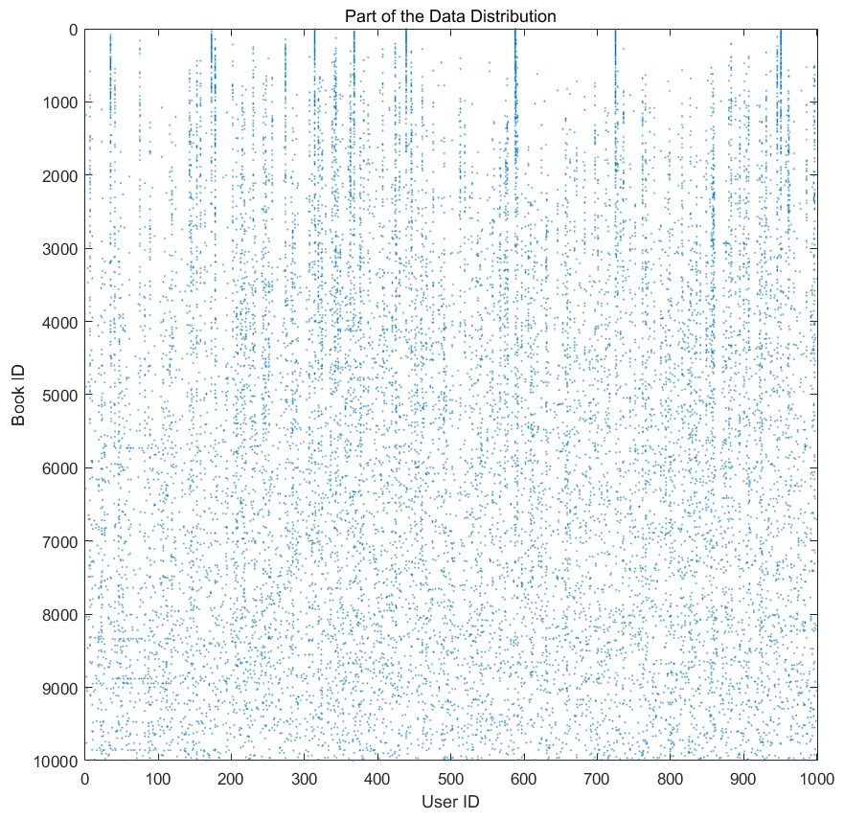
Different Collaborative Filtering Algorithms in Recommendation System
Problem: Book Recommender
Dataset:
10k * 50k, 981756 ratings, sparsity 99.82%
Methods:
Memory-based CF:
Pearson
Cosine similarity
Model-based CF:
Naïve Bayes
Probabilistic Matrix Factorization
Github repositories: https://github.com/YuZ1225/BU-EC503-Project-Fall-2018
Notes:
In fact, the recommendation system is an information filtering system. Its purpose is to predict the "rating" or "preference" a user would give to an item. So It can help us quickly find what we want to avoid overloading information. The recommendation system is mainly divided into two types. One is content-base and other is called collaborative filtering algorithm, which is more widely use. We used collaborative filter in our project.

Slide 8
Probabilistic Matrix Factorization
Factorize the (unknown) complete rating matrix R^{mxn} into two matrix U^{mxd} and V^{nxd}:
R = U * V^{T} ( + r_{m})
r_{m} is the rating offset of missing data
d is the number of latent features.
r_{m}+
R
m x n Matrix
U
m x d Matrix
V^{T}
n x d Matrix

Slide 9

Probabilistic Matrix Factorization
Using the PMF model, the problem becomes an optimization of least square problem:
Parameters:
R^{o&i}: observed and missing rating matrix
U,V: item and user matrix with latent features
W: weight matrix
d: number of latent features
r_{m}: imputed rating offset
ƛ: regularization parameter
Notes:
Matrix Factorization for Movie Recommendations
https://www.youtube.com/watch?v=aKQfUbxU96c

Slide 10

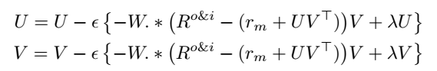
Probabilistic Matrix Factorization
Use the gradient descent to solve the problem:
For each iteration:
* To initialize U and V, we need to make them random at the beginning.
* U = ( (1 + 1 * randn(d, m)) * 1/sqrt(d/3) )';
* V = ( (1 + 1 * randn(d, n)) * 1/sqrt(d/3) )';

Slide 11
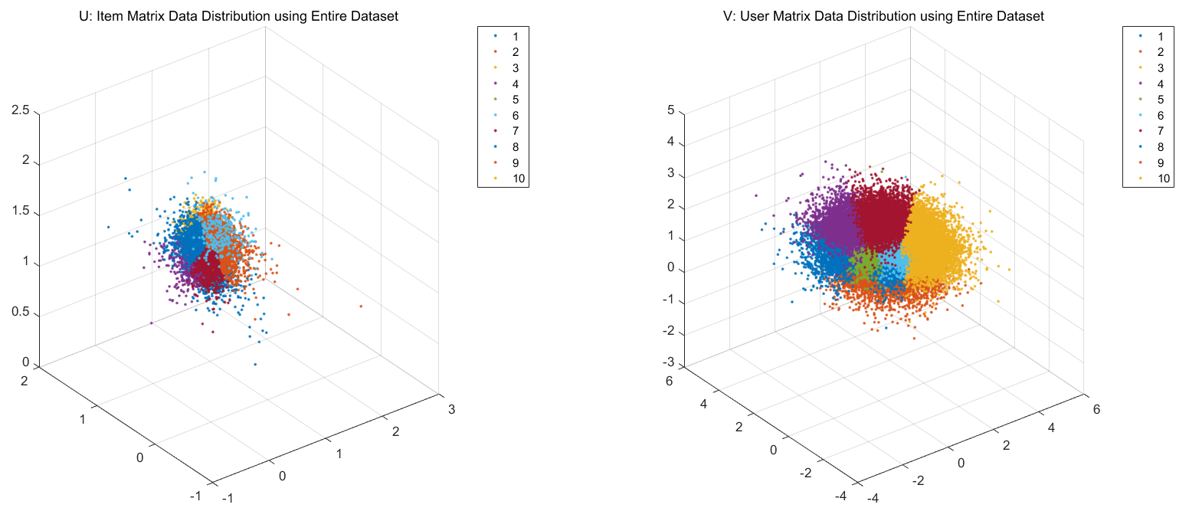
Result on Entire Dataset

Slide 12
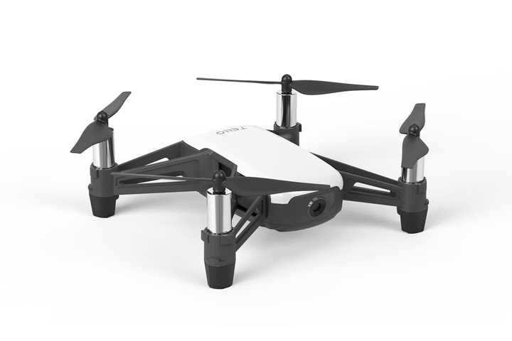

Drone Hacking
Problem: Hack a drone
Target: DJI Tello
Process:
Sniff packets:
Using Kali, WiFi adapter and Wireshark to sniff packets
Reverse engineering:
Decompile the official apk using apktool, dex2jar and jd-gui
to get useful information.
Deauthentication attack:
Using aircrack-ng to deauthenticate the current user
Result:
Extract videos from packets
Hijack script which can hijack the drone while flying
Notes:
In fact, the recommendation system is an information filtering system. Its purpose is to predict the "rating" or "preference" a user would give to an item. So It can help us quickly find what we want to avoid overloading information. The recommendation system is mainly divided into two types. One is content-base and other is called collaborative filtering algorithm, which is more widely use. We used collaborative filter in our project.

Slide 13

Classification of Brazilian Names
Problem: Identify immigrants from Brazil in the U.S.A.
Dataset:
60k full names, with 48k names labeled
Method:
Logistic Classification
KNN
Cosine Similarity
Recurrent Neural Network
Github repositories: https://github.com/YuZ1225/CS542-Project
Notes:
In fact, the recommendation system is an information filtering system. Its purpose is to predict the "rating" or "preference" a user would give to an item. So It can help us quickly find what we want to avoid overloading information. The recommendation system is mainly divided into two types. One is content-base and other is called collaborative filtering algorithm, which is more widely use. We used collaborative filter in our project.

Slide 14
Extra Code Snippet
03
Notes:
As mentioned above, Collaborative Filtering (CF) is a mean of recommendation based on users’ past behavior. There are two categories of CF: User-based:
Item-based:
In this project, we used the user-based Collaborative Filtering.

Slide 15
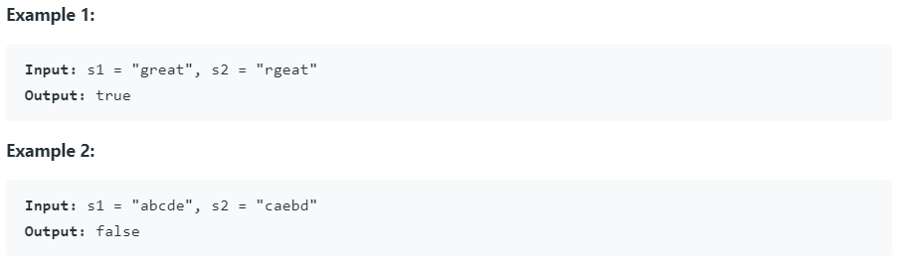
Leetcode 87. Scramble String
Given two strings s1 and s2 of the same length, determine if s2 is a scrambled string of s1.
Link: https://leetcode.com/problems/scramble-string/
My solution: https://leetcode.com/problems/scramble-string/discuss/635917/easy-understand-4ms-c-recursive-solution
Notes:
But only less than one million rating data.The range of ratings is from 1 to 5. The most rated is 4, and rating 1 and 2 are very few. Through data observation, we can conclude that the standard deviation of each book is small, but the books rating by each user are very different. The smallest one has only evaluated one, and the largest has 200.

Slide 16
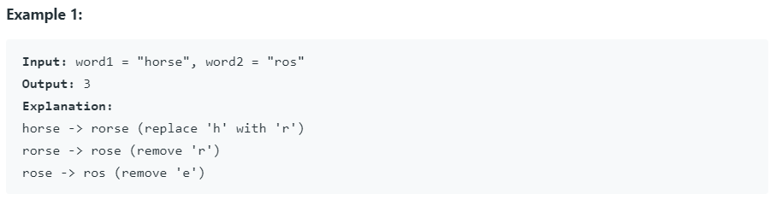
Leetcode 72. Edit Distance
Given two words word1 and word2, find the minimum number of operations required to convert word1 to word2.
You have the following 3 operations permitted on a word:
1. Insert a character
2. Delete a character
3. Replace a character
Link: https://leetcode.com/problems/edit-distance/
My solution: https://github.com/YuZ1225/Furiosa-Panel-Interview/blob/master/README.md#ed
Notes:
But only less than one million rating data.The range of ratings is from 1 to 5. The most rated is 4, and rating 1 and 2 are very few. Through data observation, we can conclude that the standard deviation of each book is small, but the books rating by each user are very different. The smallest one has only evaluated one, and the largest has 200.

Slide 17
Thanks!

Slide 18
Q & A?

